Slide 1
Software contracts and liability
Chapter 12
CS449-Professioal Issues in Information Technology
Course Instructor: Engr. Saeeda Kanwal

Slide 2
Chapter Outcome
After studying this chapter you should:
understand the purpose of contracts in the computer industry and the different types of contractual arrangement that are commonly used;
be familiar with the main issues that such contracts address;
understand the different types of liability for defective software that can arise and the factors that affect these.

Slide 3
What is a Contract?
A Contract is an agreement between two parties that creates an obligation to perform (or not to perform) a particular duty.
A legally enforceable contract requires:
1. An Offer (I’ll mow your lawn this weekend, if you pay me $30)
2. An Acceptance (You’ve got a deal)

Slide 4
What is a Contract ?......
A contract is simply an agreement between two or more persons (the parties to the contract) that can be enforced in a court of law. The parties may be legal persons or natural persons.
There is no specific form for a contract; in particular, a contract need not be written down. What is essential is:
all the parties must intend to make a contract;
all the parties must be competent to make a contract, that is, they must be old enough and of sufficiently sound mind to understand what they are doing;
there must be a ‘consideration’, that is, each party must be receiving something and providing something.

Slide 5
What is a Contract?......
Contract law is largely based on common law. It has a long history and is well adapted to handling the disputes that arise in fulfilling commercial agreements.
The existing contract law showed itself perfectly enough to handle contracts for the supply of computers, software and associated services.
However, the coming of the internet and e-commerce has created a need for new provisions to deal with such matters as electronic signatures, and which country’s laws should govern transactions made over the internet, when the parties to the transaction are in different countries.

Slide 6

What is a Contract ?......
Hilary Pearson made a very telling statement when she said, “while optimists make the best deal makers, pessimists make the best contract writers”.

Slide 7
What is a Contract ?......
Some disputes are often unavoidable because they are caused by circumstances beyond the control of the contracting parties.
It is important that the contract is properly drawn up, for at this stage it will be interpreted by outsiders, for example by lawyers and judges, accountants or a trustee in bankruptcy.

Slide 8
Drafting Contracts
A Contract Must be:
Made in a Clear and logical manner
Complete and consistent
Clear from ambiguity
Software Engineers deal with different types of contracts like:
Insurance
Employment
Suppliers
Consultancy etc.

Slide 9
Structure of Contract
Structure of Contract must have:
A short introductory section
What is to be produced
What is to be delivered (as Annexes)
Source code
Command files
Documentation and design files
Reference manuals, training manuals
Test data and test result etc
Ownership of rights
License and exclusive license

Slide 10
Introductory section
It often begins with a set of definitions of terms used in the course of the agreement.
These definitions explain precisely what the parties mean by certain words or phrases.
For example, the definitions section will tell us that Company X Ltd, the software house, is to be referred to throughout the contract as “The Company”, and Company Y Ltd, which has commissioned the work, is to be known throughout as “The Client”.

Slide 11
Introductory section….
It states that the contract consists of the introductory section itself, the standard terms and conditions, the annexes (which should be listed), together with any documents listed in the annexes,
such as the requirements specification (discussed in the paragraph below) and nothing else.
‘Nothing else’ is important to avoid misunderstanding because any other things which might have come up during discussions or negotiations are excluded.

Slide 12
What is to be produced
There are usually two levels of reference here:
the standard terms and conditions refer to an annex
the annex then refers to a separate document which constitutes the requirements specification.
This is very easy because requirements in software never change.

Slide 13
For changes
Contracts may also provide a procedure for making variations to the specification.
It must provide a method of calculating payment for the work done to facilitate the changes.
It must include the method for acceptance testing.

Slide 14
Ownership
It is important that the contract should also state what legal rights are being passed by the software house to the client under the contract.
Can a software house reuse the same code to make a similar system later on?

Slide 15
Ownership…..
It is important for the contract to state precisely who is to own these rights.
Software is potentially protectable by a number of intellectual property rights, such as copyright, design rights, confidentiality and trade marks.
If the person who creates the software is an employee acting in the course of employment, the copyright belongs to the employer.
Ownership in copyright is passed only by written assignment or transfer.

Slide 16
Ownership…..
If ownership of copyright passes to the client it is known as a sale or assignment and a written agreement is necessary.
If copyright is to remain with the software house and the client is merely given permission to use the software, this is known as a license.
It can be an exclusive license as well.

Slide 17
Granting of license
Duration of license
Period of license and termination method
Transfer of license
Scope of license
One computer, one site (e.g. campus)
Confidentiality
Cannot allow any one but employees to use it
What happens if supplier winds up the business?

Slide 18
Payment Terms
Payment Terms:
Time limit needs to be addressed.
Payments must be made in specified times, otherwise, ‘x’ amount of interest may apply.
Payment made all at once or pay different amounts throughout the duration.

Slide 19
Delays/ changes
The contract needs to have annex terms for rates.
Charges for delays will be calculated using these terms.
What if the delays affect any other projects?
Delayed payments and payments for variations to the original requirements are, perhaps, the commonest cause of contractual disputes.

Slide 20
Delays/ changes…..
What happens if the delay is because of the supplier?
Contract could specify deducting a specific amount for each week the product is delayed.
Even though such delays are normal, these penalty clauses are rare.

Slide 21
Obligations of the client
What if you require a certain document, but the client is unwilling to share it?
The general terms and conditions will normally state that a list of specific obligations and the dates at which they will be required is given in an annex.

Slide 22
Standards and methods of working
Arraigning Progress meeting
Meetings with Project managers
What will be the Acceptance procedure
Warranty and maintenance Indemnity (means security): Advisable to include a clause under which each party indemnifies the other for liability arising from its own faults in this respect.

Slide 23
Standards and methods of working
Termination of contract
Arbitration: is a technique for the resolution of disputes outside the courts.
Inflation
Applicable law

Slide 24
CONTRACT TYPES

Slide 25
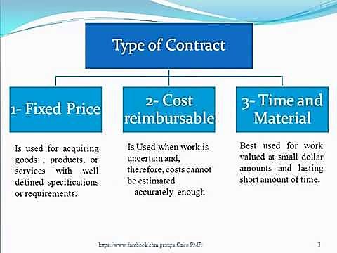

Slide 26
Fixed Price also called "Lump Sum“
Fixed Price Contract:
This contract is also known as Lump sum contract. The seller and the buyer agree on a fixed price for the project. The seller is bound to accept high risk in this type of contracts.
The buyer is in least risk category as the price is already fixed and there is an agreement on the same from seller side as well. There must be fully detailed specifications, checklists, project scope statements from the seller side which buyer will use.

Slide 27
Fixed Price ….
Sometimes it seems that a seller try to cut the scope to deliver the projects on time and within budget. This is a threat really for the buyer. A good project is finished on time and with the desired quality.
However, if the project is delayed and there are cost overruns, then the seller will absorb all that extra costs.
Fixed price contracts are typically used in government based projects. Advantages of fixed price contracts include throwing all the risk on the seller. Disadvantages is that the seller starts cutting scope in order to finish on time and within budget.

Slide 28
Contract hire
Contract hire:
Supplier’s responsibility is limited to providing suitably competent people and replacing them if they become unavailable.
The staff work under the direction of the client.
Payment is on the basis of a fixed rate for each day worked.
Ownership of intellectual property rights generated in the course of the work may need to be addressed.

Slide 30
Time and Materials (hybrid)
Time and Materials (hybrid):
In this type of contract, payment is made on the basis of the costs incurred, with labor charged in the same way as for contract hire.
This is somewhere between a contract hire agreement and a fixed price contract.
This contract is usually used when requirements of the project are not clear enough as to allow a fixed price, or Usually when hardware is also required.

Slide 31
Consultancy
Consultancy:
The outcome of a consultancy project is usually a report or any other related document.
Under normal circumstances a fee for IT consulting is assessed on a per day, per consultancy basis.
Fixed fee IT consulting contract applies to projects which are well defined.
Open ended consultancy contract generally favor the consulting firm, as the consultancy firm charges on a per day basis, there is no incentive to complete the task within a fixed period. This increases the risk of project completion and cost overrun, but the contract is very simple.

Slide 32
Four important aspects of a consultancy contract
Four important aspects of a consultancy contract:
Confidentiality: Consultants may learn about client’s confidential information.
Terms of reference: What reports/ workflows etc. the consultant might need to refer to. Issues arise when matters which were not considered beforehand may be needed to be addressed.
Liability: How to decide liability on an advice?
Final report acceptance: Usually a draft version before the final product.

Slide 33
Outsourcing
Outsourcing:
Sometimes known as facilities management.
Company or organization (the customer) hands Professional Issues in Information Technology over the planning, management and operation of certain functions to another organization (the supplier).
Any examples you can think of?

Slide 34
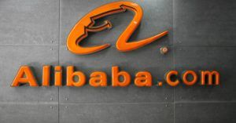
For many, Alibaba.com is China’s eBay but few know that it started as a small “internet company” called China Yellow Pages. Today Alibaba is the world’s biggest global marketplace, one that in 2014 when it went public, was able to score the biggest IPO to these day.
Well, according to the book "Alibaba: The Inside Story Behind Jack Ma and the Creation of the World's Biggest Online Marketplace", in its early days, the founder Jack Ma outsourced the website development to a U.S. firm. At the time, development talent in China was in short supply, while developers in U.S. had the skills Alibaba was looking for and needed. That’s just one reason, though. The other being Ma had to find workarounds and viable ways to grow his company overcoming all Chinese internet restrictions. Currently, the company still relies on outsourcing partners for production, but they're mainly located in China.

Slide 35
Outsourcing….
IT outsourcing contracts are inherently complex and depend very much on individual circumstances.
Some important points to consider:
How the performance to be monitored and managed;
What happens if performance is unsatisfactory;
Which assets are being transferred;
Staff transfers;
Audit rights;
Contingency planning and disaster recovery;
Intellectual property rights in software developed during the contract;
Duration of the agreement and termination provisions.

Slide 36
Cost Reimbursable Contracts:
Cost Reimbursable Contracts:
The name is self-explanatory here. The seller will work for a fixed time period and after finishing the work he will produce a bill and the buyer will pay this amount.
This is almost negative for a buyer. A seller may charge an unknown amount which the buyer has to pay. The seller is at advantage in this contract, not the buyer. That’s the reason this type of contract is rarely used in the real world.

Slide 37
License Agreements
License Agreements:
When customers buy a software, they are buying a copy of the software together with the right to use it in certain ways.
A license may allow the licensee to use one copy of the software on his computer.
A license may allow the licensee to run the software on a server on his local area network and for it to be used by any number of users simultaneously, up to some agreed maximum number.

Slide 38
License Agreements…..
This type of license is used, for example, for large multi-user database management systems and for applications such as accounting packages intended for the corporate market.
A license may allow the licensee to run as many copies of the software as he wishes on computers at specified premises. This is also known as a site license.

Slide 39
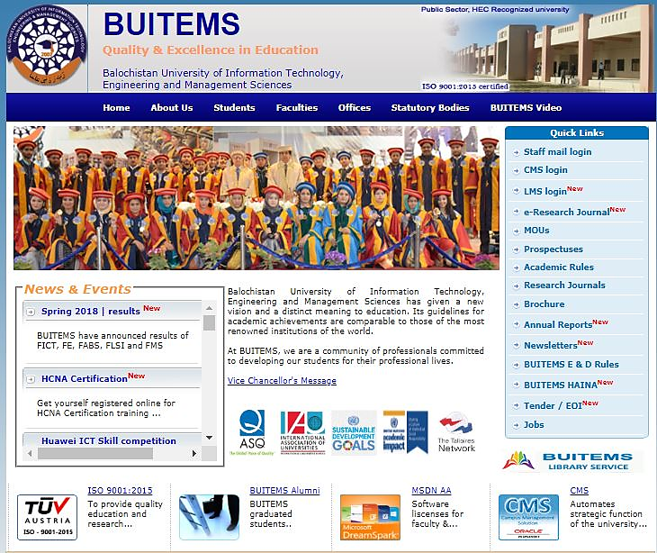

Slide 40
Some important things to consider
Limiting the extent to which the customer can use the software, so that if the customer wants to use it more extensively he must pay an additional license fee;
Ensuring a regular income from support activities, possibly an annual maintenance charge, possibly fees for consultancy services;
Ensuring that, as far as is possible, it will not be liable for any defects in the software.

Slide 41
LIABILITY FOR DEFECTIVE SOFTWARE
Suppliers of software and hardware are very reluctant to give a contractual commitment that it is fit for any purpose whatsoever.
Standard terms and conditions will invariably contain a clause that tries to limit the supplier's liability if it turns out that the software or hardware is defective.
The law, however, limits how far such clauses can be effective.

Slide 42
LIABILITY FOR DEFECTIVE SOFTWARE….
Most contracts will limit the extent of any liability either to the purchase price of the product or to some fixed maximum figure.
This means that, if the product completely fails to work, the supplier agrees to refund the purchase price or possibly a bit more if some other maximum is specified.
The Unfair Contract Terms Act 1977 restricts the extent to which clauses in standard terms and conditions limiting liability can be effective.

Slide 43
LIABILITY FOR DEFECTIVE SOFTWARE….
In particular, it is not possible to limit the damages payable if a defect in the product causes death or personal injury.
This applies as much to software as it does to motor vehicles.
Thus if a company supplies software to control a light railway link and a defect in the software leads to an accident in which people are killed or injured, then any clause in the contract for the supply of that software that claims to restrict liability will not be enforceable in respect of the claims for damages for the deaths and injuries

Slide 44
LIABILITY FOR DEFECTIVE SOFTWARE….
This restriction is an important one for companies that produce safety critical software and it also led at least one hardware supplier to refuse to sell its products to the nuclear industry.
Although this is very relevant when buying a motor car, it is not very relevant to most individuals or companies when dealing with software, because the software they use or develop is very unlikely to cause death or personal injury.
They are much more likely to be concerned about software that doesn’t do what it was claimed to do or that has too many bugs to be usable.

Slide 45
HEALTH AND SAFETY
The Health and Safety at Work Act (1974) states: ‘It shall be the duty of every employer to ensure the health, safety and welfare at work of all his employees.’
It breaks this duty up into a number of more specific tasks. The ones that are of particular concern to software engineers are:
provision and maintenance of safe plant;
provision and maintenance of safe systems of work;
provision of such information, instruction, training, and supervision as necessary;

Slide 46
HEALTH AND SAFETY….
ensuring the workplace is maintained in a safe condition;
provision and maintenance of a safe working environment and adequate welfare arrangements.
The Act also requires employers to ensure that their activities do not expose the general public to risks to their health and safety. Manufacturers of equipment to be used at work also have a responsibility to ensure that it is safe.
Failure to comply with the Health and Safety at Work Act is a criminal offence and, in serious cases, can lead to criminal proceedings being taken against individuals.

Slide 47
HEALTH AND SAFETY….
Trains, ships and airplanes are all places where people work and where the general public are present.
The safety obligations listed above therefore apply to them. Furthermore, they all involve equipment that is controlled by software and accidents may occur as a result of defects in that software.
Modern manufacturing plants are usually software controlled and can be dangerous; robots in particular can be dangerous for people working with them.

Slide 48
HEALTH AND SAFETY….
Modern chemical plants, oil refineries, and power stations, especially nuclear ones, are all software controlled & software failures can result in accidents that affect not only the workforce but also the general public.

Slide 49
Contract Sample!
http://www.lds-tech.com/Sample%20Contract.pdf

Slide 50
References
http://www.law.cornell.edu/wex/contract
http://www.vakilno1.com/saarclaw/pakistan/the-law-of-contract-in-pakistan.html
Gillette, Clayton P., "Standard Form Contracts" (2009). New York University Law and Economics Working Papers. Paper 181.
http://lsr.nellco.org/nyu_lewp/181
http://www.softwarecontracts.net/

